Slide 1
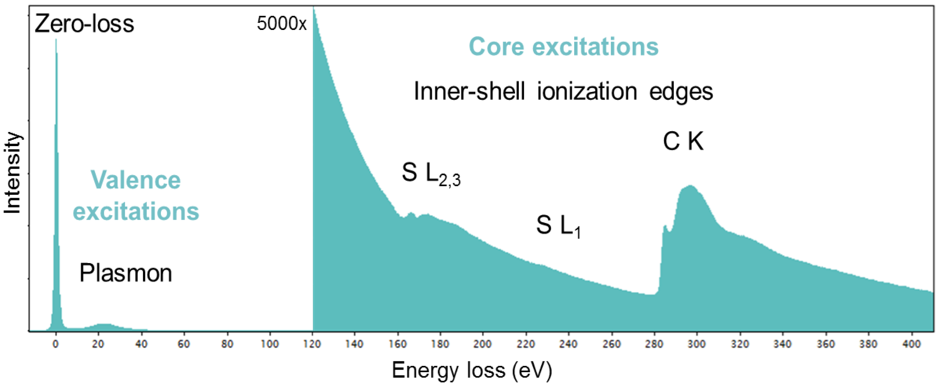
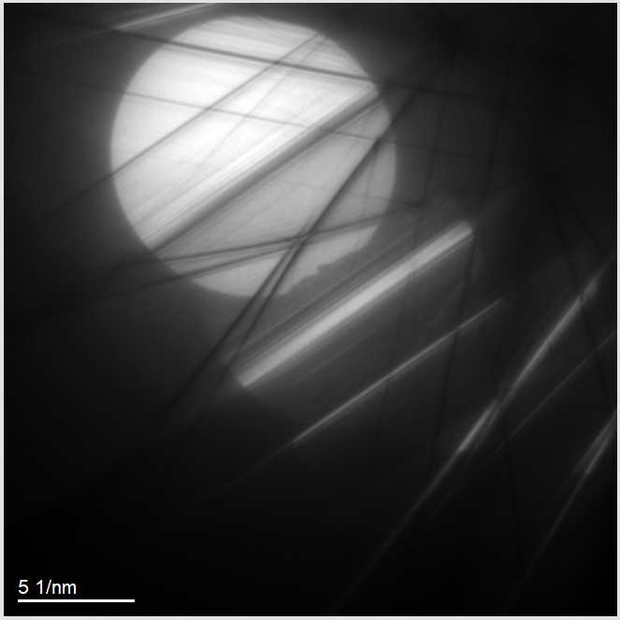
Thickness Measurement in TEM
EELS vs CBED

Slide 2
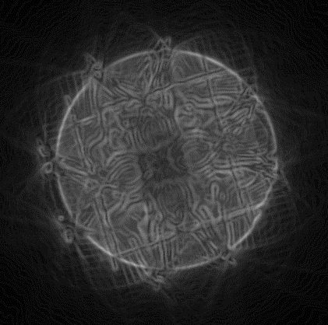
Agenda
What possibilities exist?
A little bit bout EELS
A little bit bout CBED
Show-case Aluminum CBED
Show-case Aluminum EELS
Hints & “the program”
Possible & Planned Extensions of Program

Slide 3
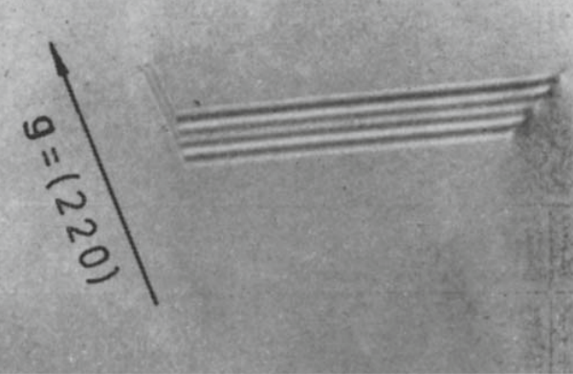
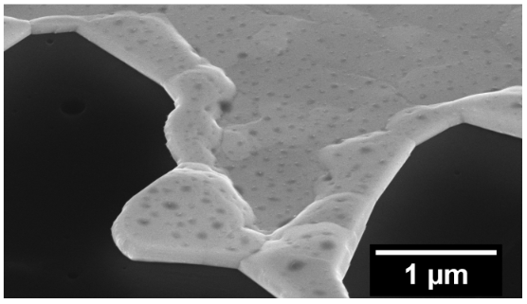
What possibilities exist?
FIB cross-section
Thickness-Fringes
Projected widths/ Planar Defects
EELS
KM- fringes (CBED)
…..
Williams & Carter

Slide 4
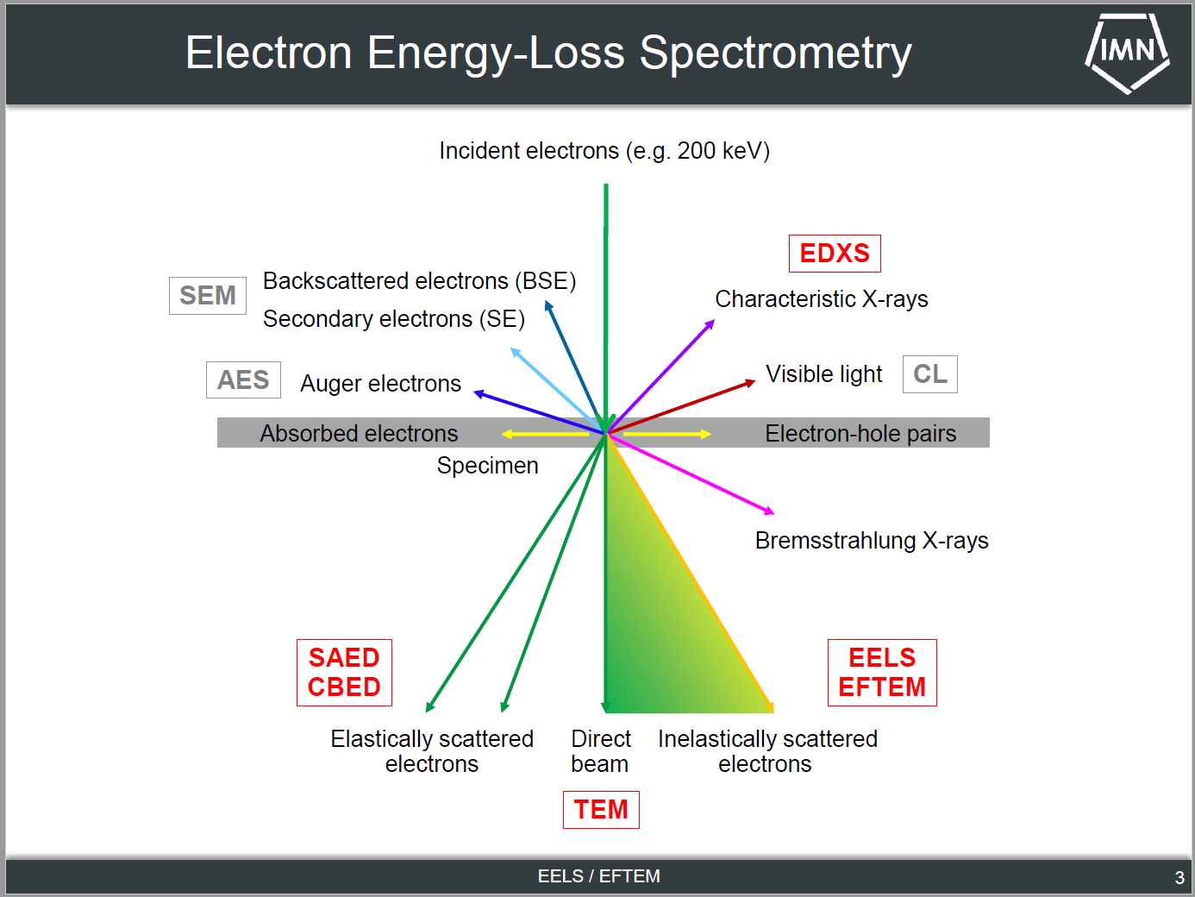
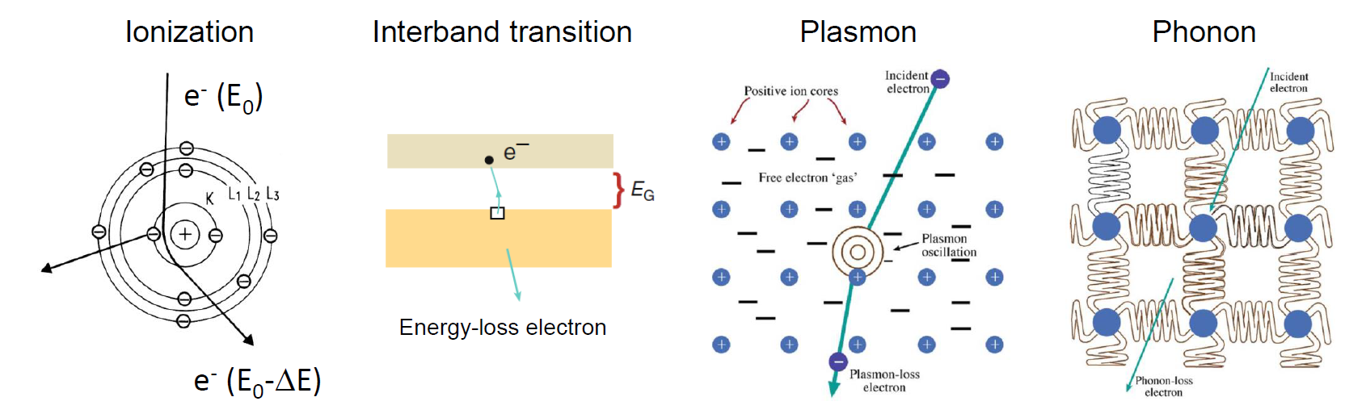
A little bit bout EELS (Electron Energy-Loss Spectrometry)
EELS: Analysis of energy spectrum of transmitted electrons. Energy losses through:
Low energy-loss:
Zero-loss
Plasmons
Inter-Intraband transitions
High energy-loss:
Ionization edges
…
→ Composition, band structure, specimen thickness, …..

Slide 5
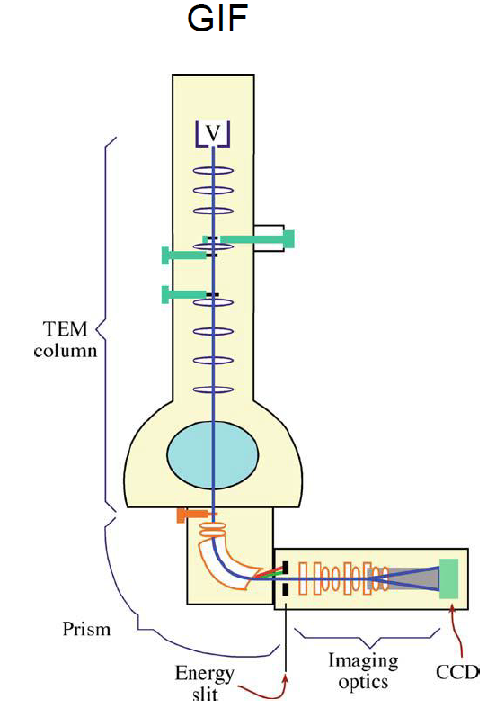
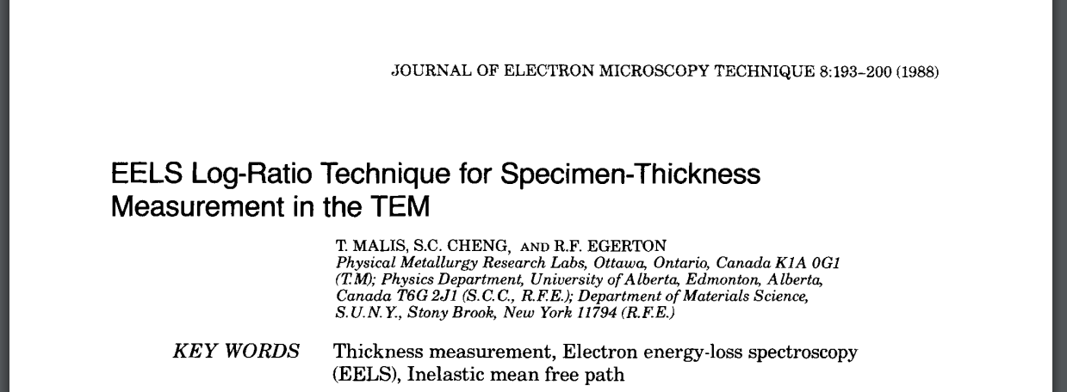
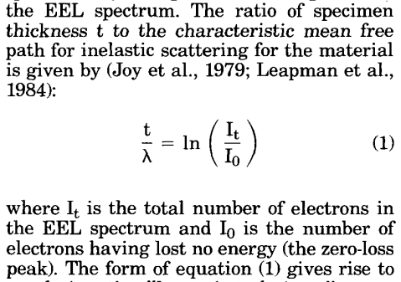
A little bit bout EELS (Electron Energy-Loss Spectrometry)
Spectrometers:
PEELS: Parallel- collection EELS
GIF: Gatan Imaging Filter
Ω: Omega Filter
EFTEM

Slide 6
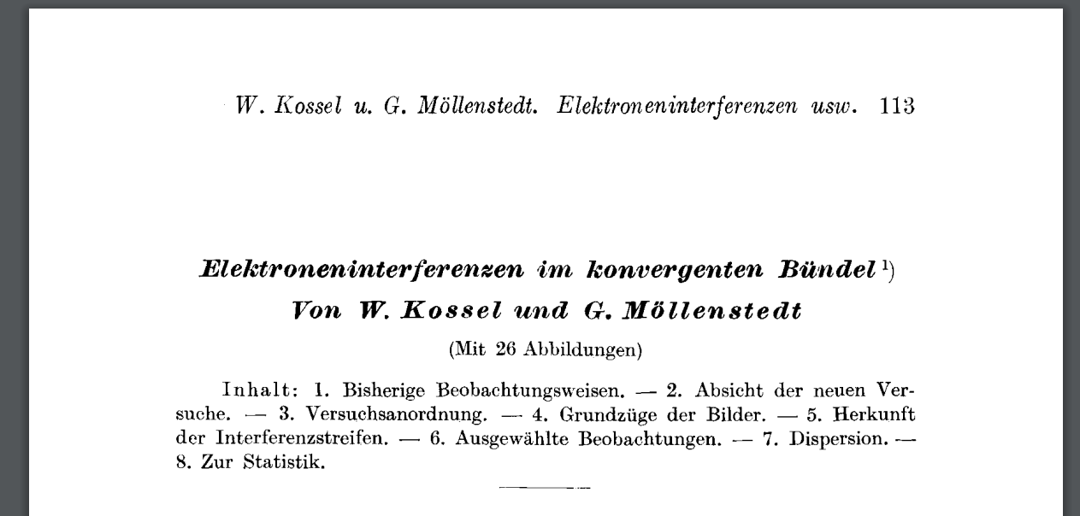
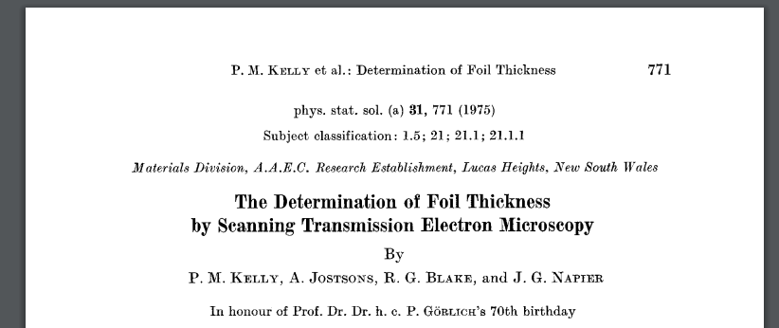
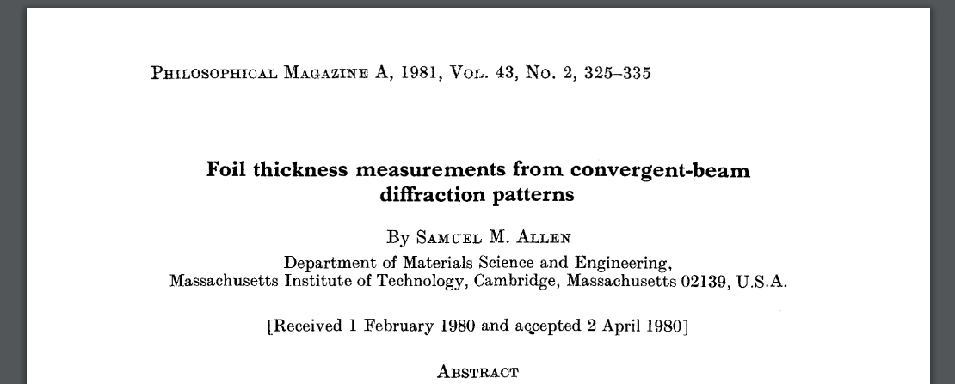
A little bit bout CBED (Convergent Beam Electron Diffraction)
Based on measuring Kossel and Möllenstedt fringes (K-M) in g spot
Theory described by Kelly & refined by Allen et al.
„[…] im Inneren der Scheiben aber zeigen sich Intensitätsschankungen, die von der merklich gewordenen Ausdehnung des Gitters in die Tiefe Herrühren.“ –Kossel 1939
Interesting artikle on CBED and Nazis: https://blogs.kent.ac.uk/sciencecomma/2019/12/13/scientific-discovery-under-nazi-rule/
Möllenstedt’s auto-biography: https://sci-hub.se/https://doi.org/10.1016/S1076-5670(08)70060-0
Really easy to read paper „about everything“: https://sci-hub.se/https://doi.org/10.1016/S0031-8914(40)90101-X
Notes:
MacGillavry
Staff and their families either went with the equipment on the SS Deutschland or via the Wilhelm Gustloff [30]. Both ships were heading to Kiel in Germany. Sadly, those who went via the Gustloff became part of the worst maritime disaster in history [31].
Built only to accommodate 1900 people, upwards of 10,000 people desperately packed onto the ship. The temperature outside was viscously cold, minus 18 degrees, so cold the life boats had frozen to the deck. Two of the ships accompanying the Gustloff had technical troubles and returned to Danzig, leaving only one torpedo boat. When a Soviet submarine encountered the Gustloff on the eve of January 30th, it was a sitting duck. Over 9000 people died.
SS Deutschland
Fortunately for Kossel and Möllenstedt, they decided to take the SS Deustchland

Slide 7
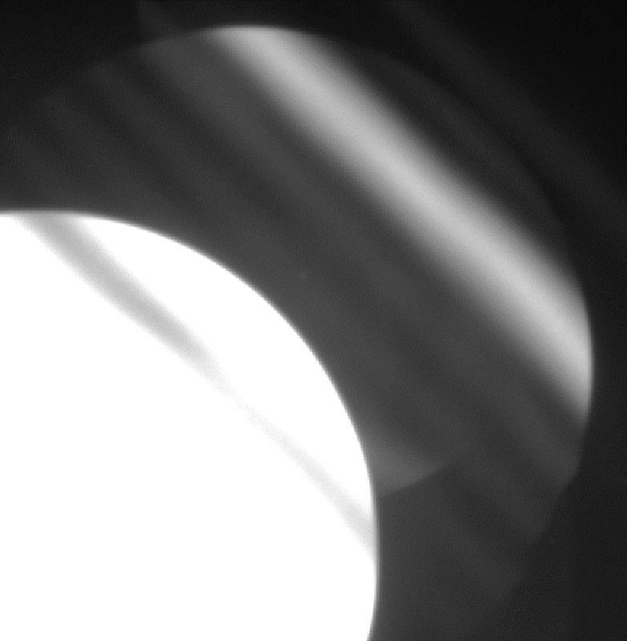
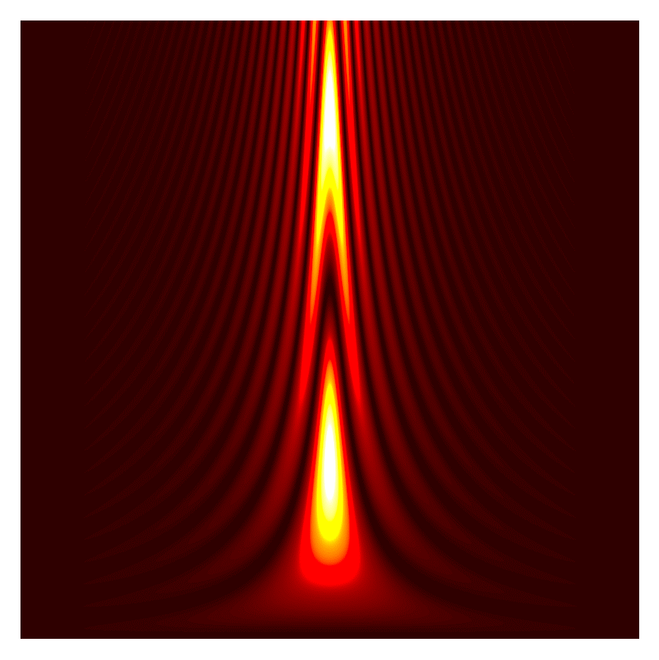
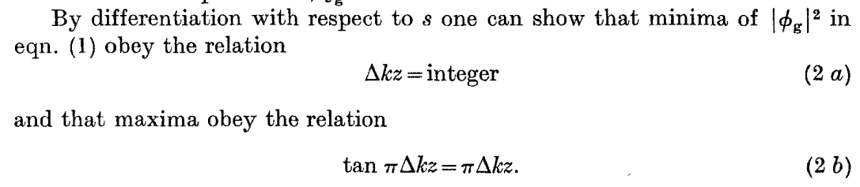
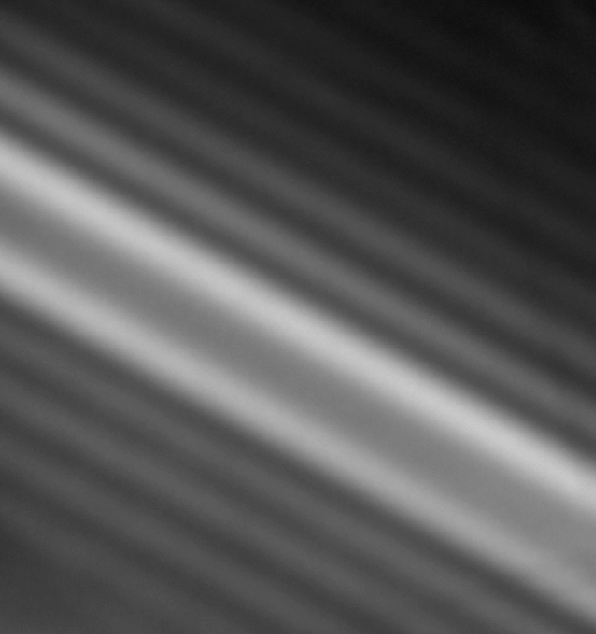
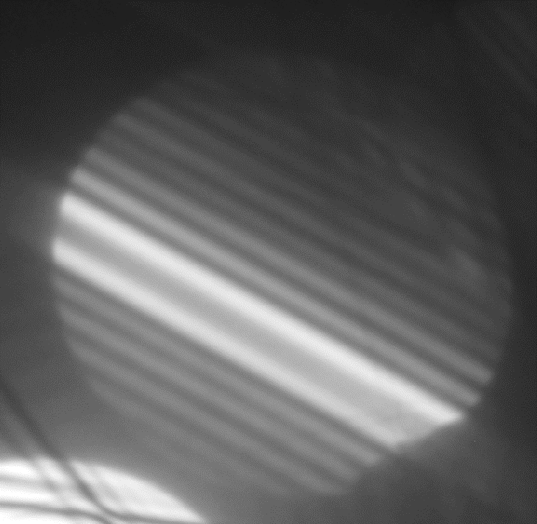
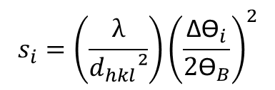
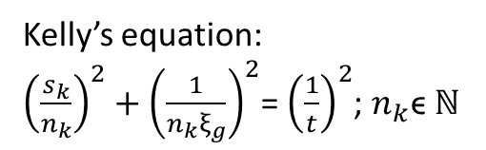
A little bit bout CBED (Convergent Beam Electron Diffraction)
Rocking- curve: Intensity distribution with the change of diffraction conditions due to dynamical diffraction.
Workflow:
Obtain CBED from 2-Beam Condition
Measure Δϴ_{i}
Calculate s_{i}
Plot Kelly’s equation
Change n_{i} until linear
K-M pattern
Sample thickness (t)
Δϴ₃
Δϴ₂
$${s_{i}=\left(\frac{λ}{d_{hkl}²}\right)\left(\frac{{\text{Δϴ}}_{i}}{{\text{2}\text{ϴ}}_{B}}\right)}^{2}$$
Allen
Δϴ₁
Kelly’s equation:
${\left(\frac{s_{k}}{n_{k}}\right)}^{2}+{\left(\frac{1}{n_{k}ξ_{g}}\right)}^{2}$= ${\left(\frac{1}{t}\right)}^{2}$; $n_{k}$ϵ ℕ
s = 0
s₀ s₁ s₂ s₃

Slide 8
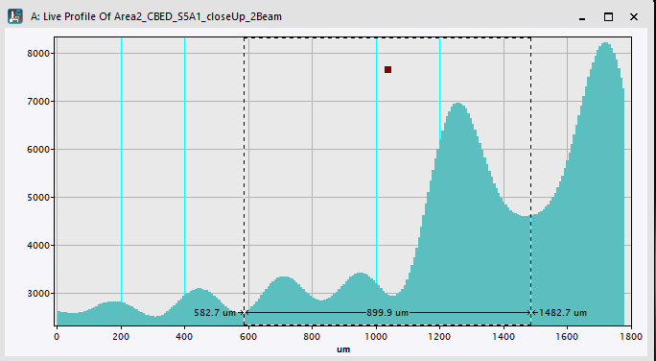
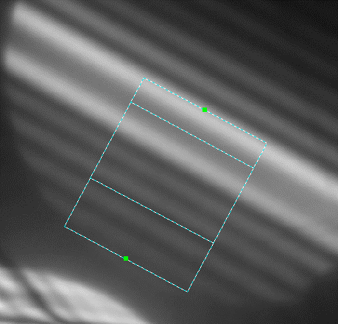
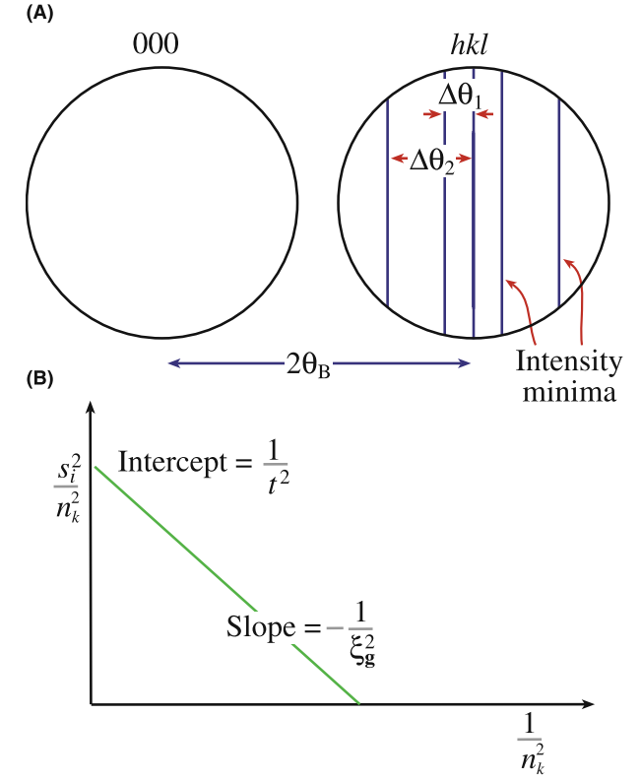
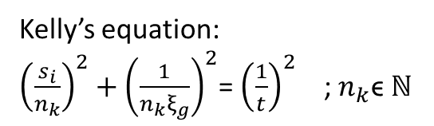
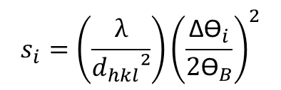
A little bit bout CBED (Convergent Beam Electron Diffraction)
Workflow:
Obtain CBED from 2-Beam Condition
Measure Δϴ_{i}
Calculate s_{i}
Plot Kelly’s equation
Change n_{i} until linear
$${s_{i}=\left(\frac{λ}{d_{hkl}²}\right)\left(\frac{{\text{Δϴ}}_{i}}{{\text{2}\text{ϴ}}_{B}}\right)}^{2}$$
Kelly’s equation:
${\left(\frac{s_{i}}{n_{k}}\right)}^{2}+{\left(\frac{1}{n_{k}ξ_{g}}\right)}^{2}$= ${\left(\frac{1}{t}\right)}^{2}$ ; $n_{k}$ϵ ℕ
y
x
m
y(x=0)
Williams & Carter

Slide 9
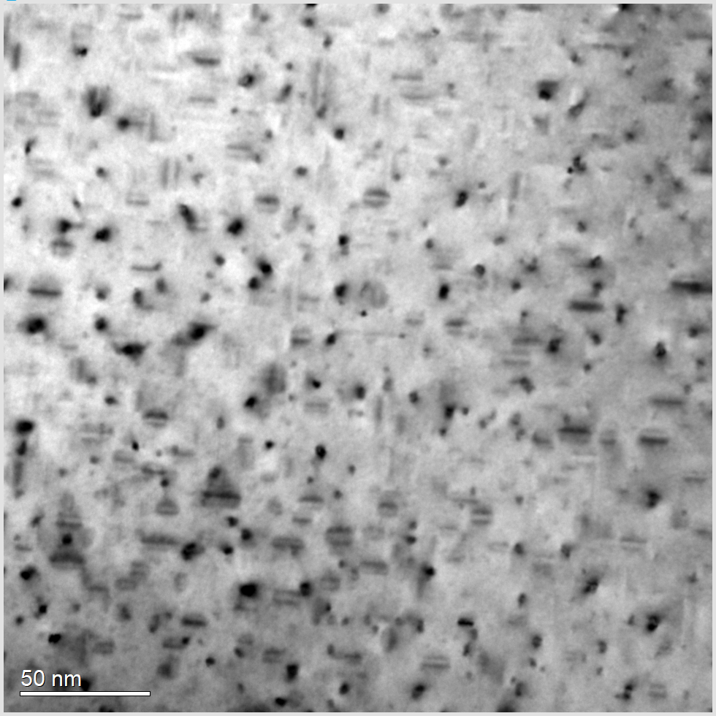
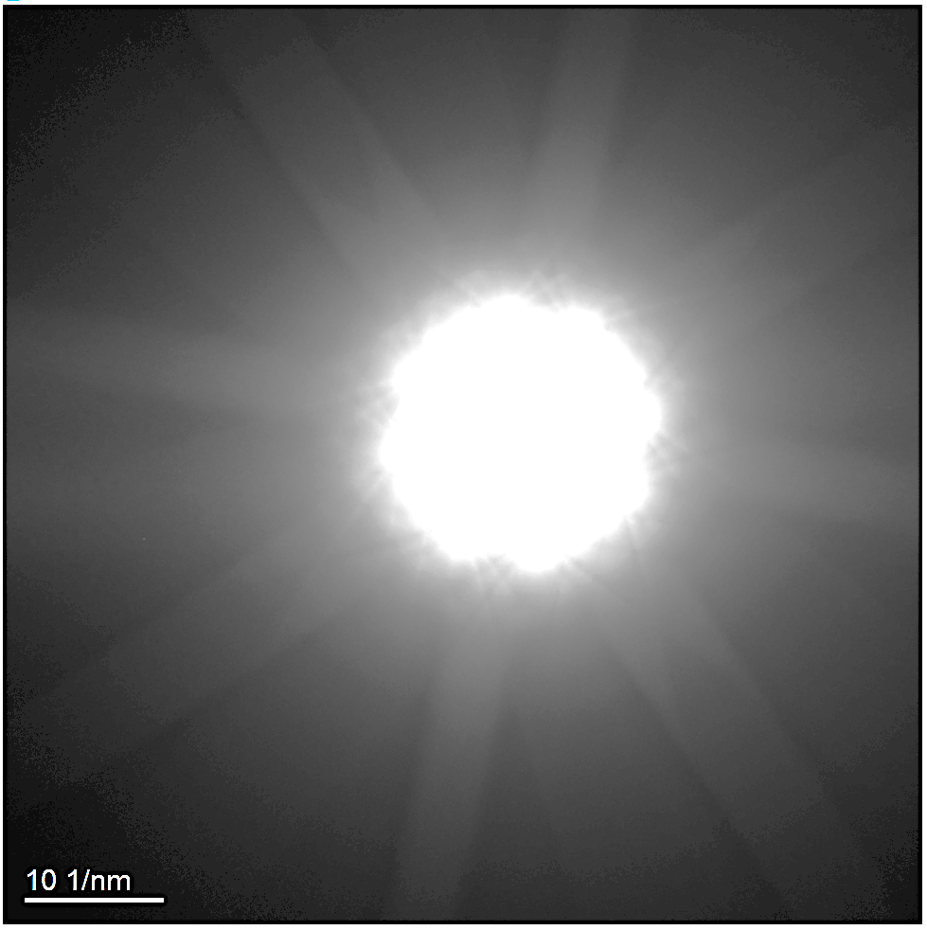
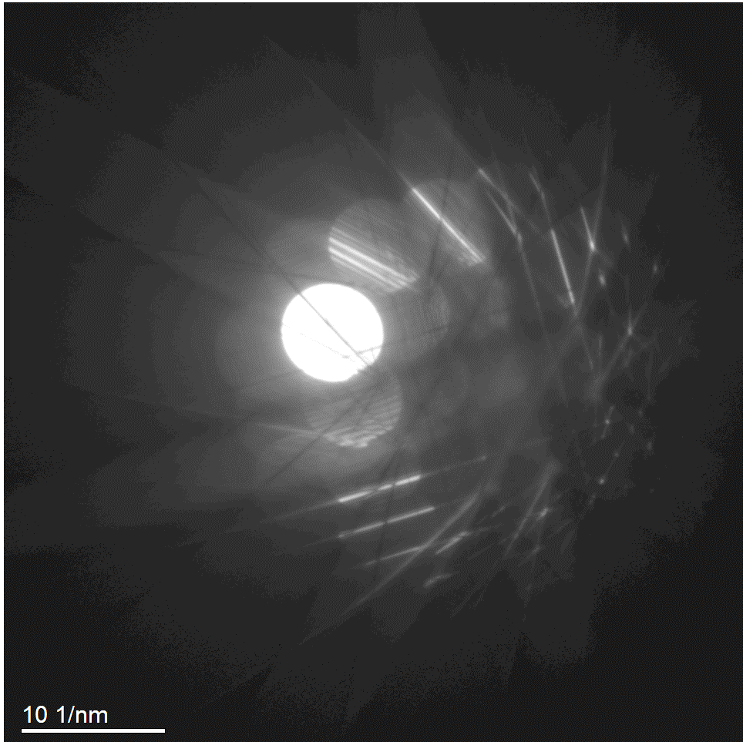
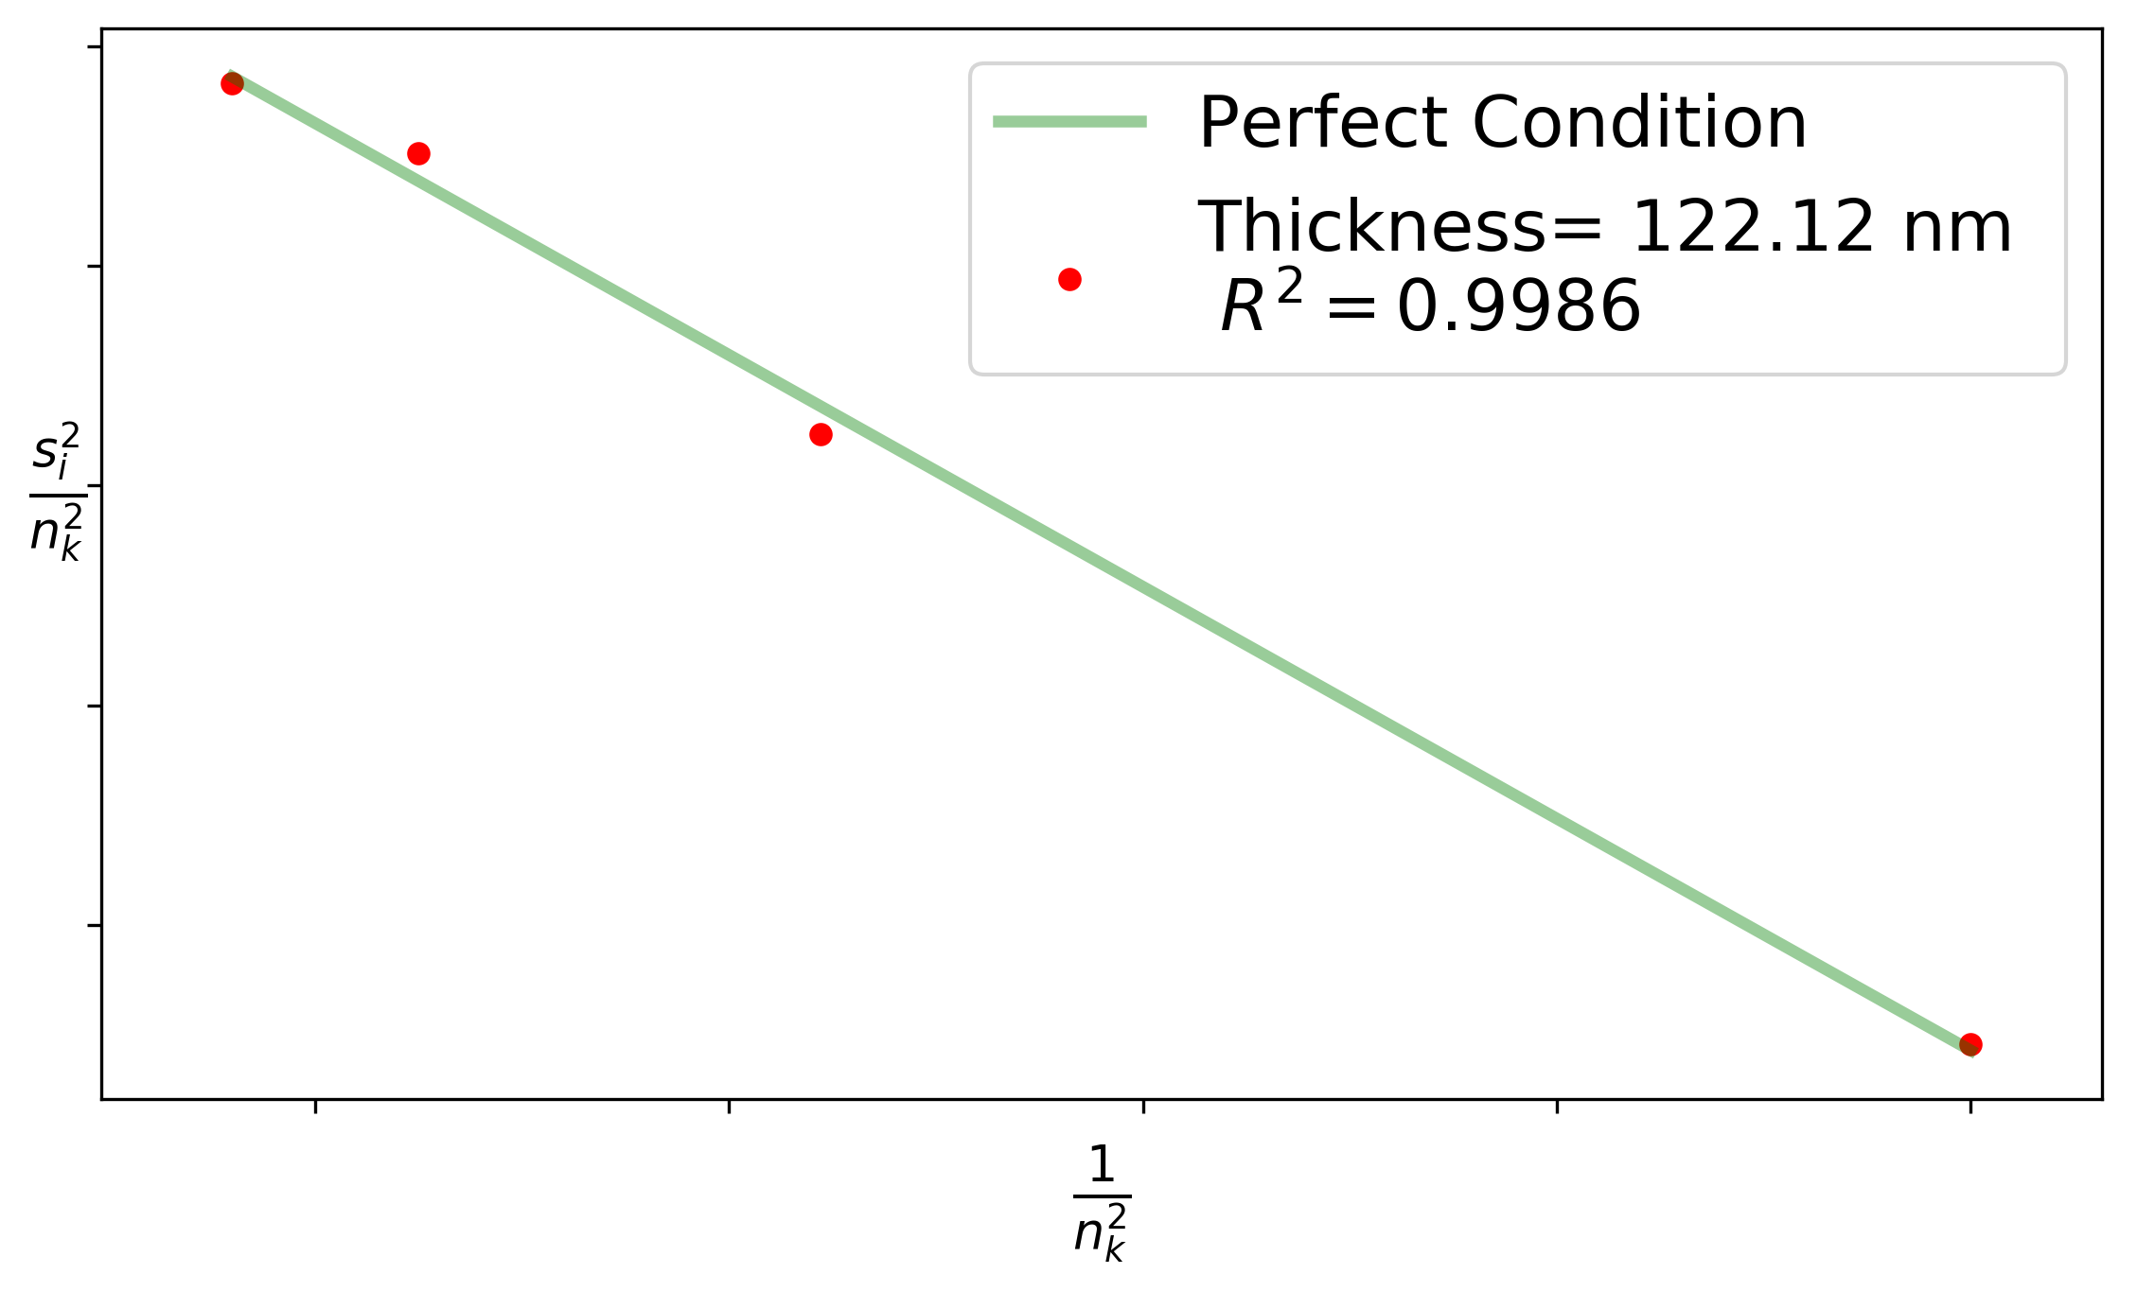
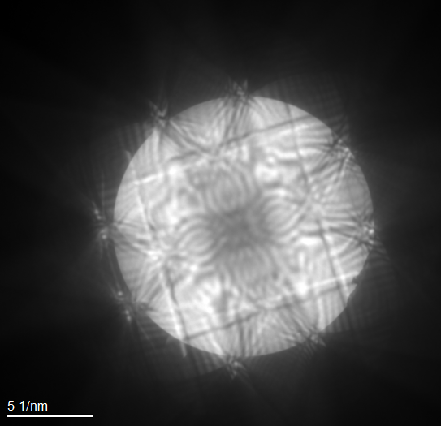
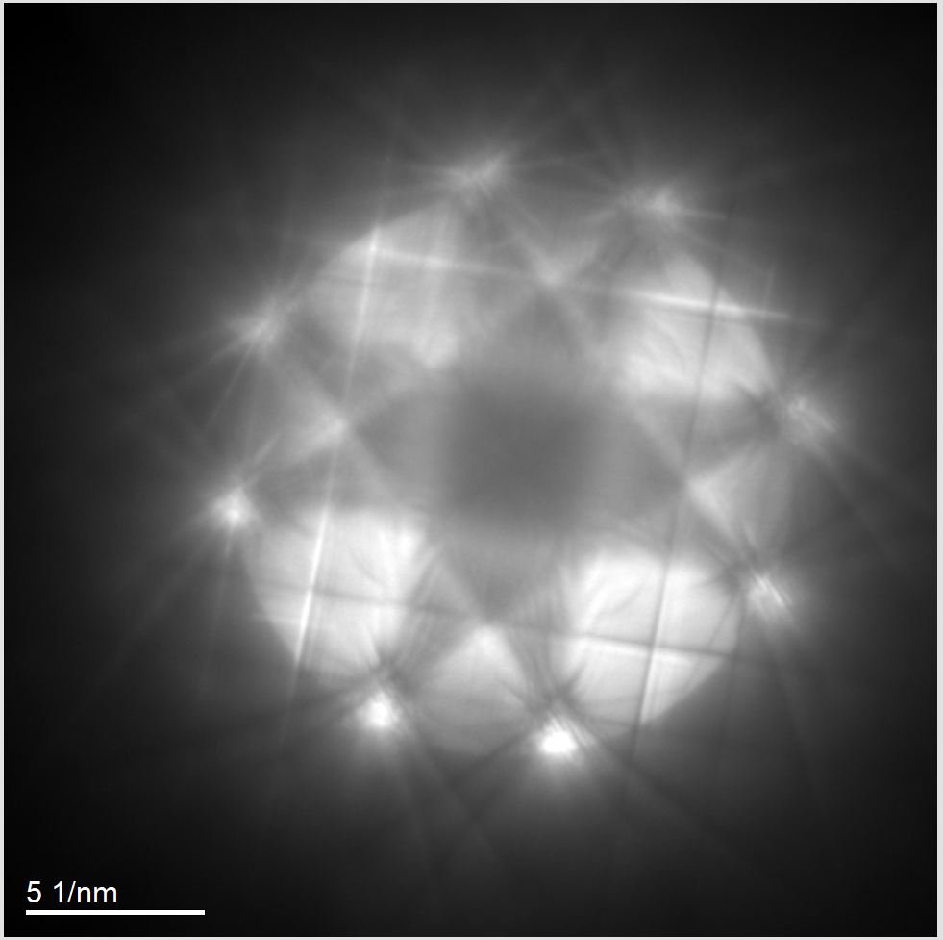
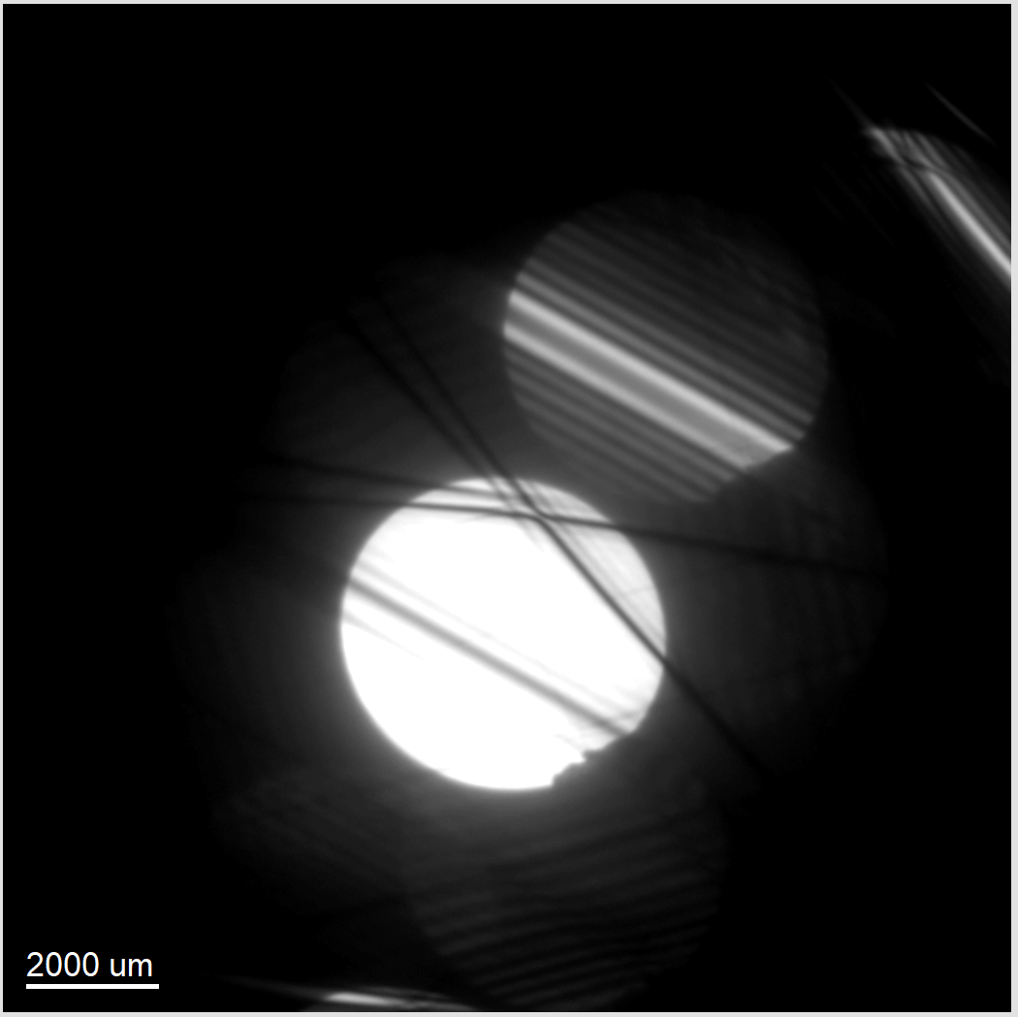
Show-case Aluminum CBED
<220>
<200>
S1A3
S5A1

Slide 10
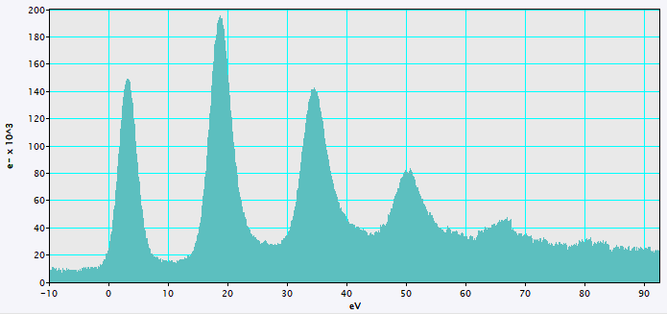
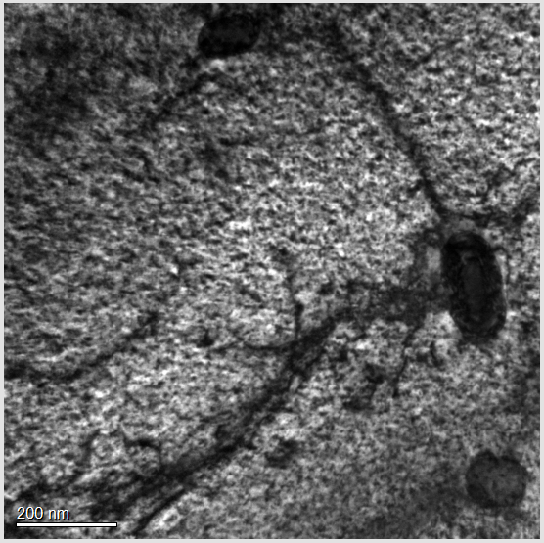
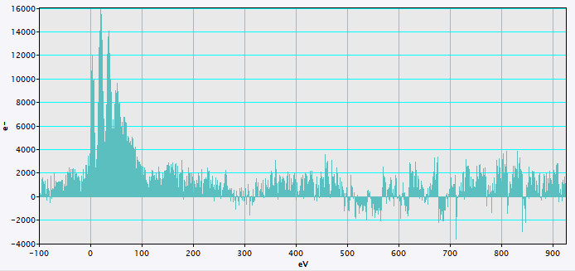
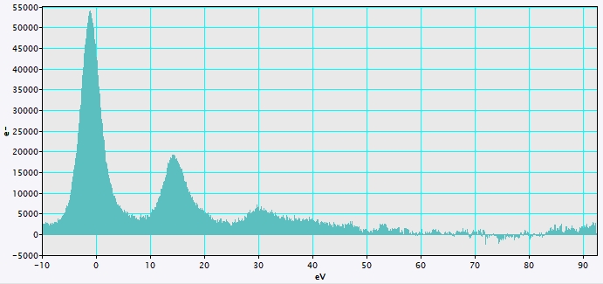
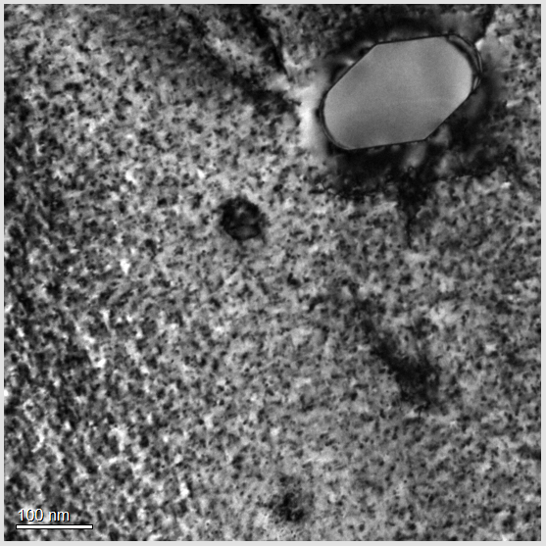
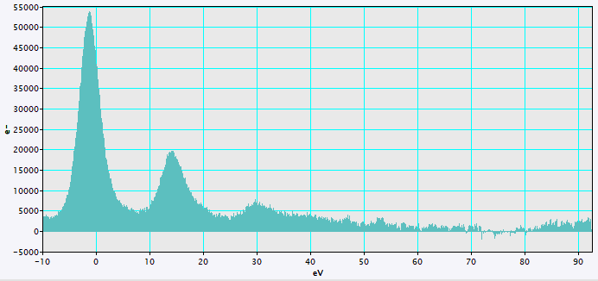
Show-case Aluminum EELS
337.6 nm
Thickness- through EELS:
20% accuracy ( original Paper)
GIF @2100: negative counts
GIF @2100: energy gain
Area1
Cumulative vs. Calin’s 0.15 sec
270.4 nm
128 nm
Area2
Cumulative with same e⁻ count
λ_{P} ^{Al} : 160 nm
156.8 nm
Values for λ_{P} taken from : https://www.researchgate.net/publication/259329092_Mean_free_path_of_inelastic_electron_scattering_in_elemental_solids_and_oxides_using_transmission_electron_microscopy_Atomic_number_dependent_oscillatory_behavior

Slide 11
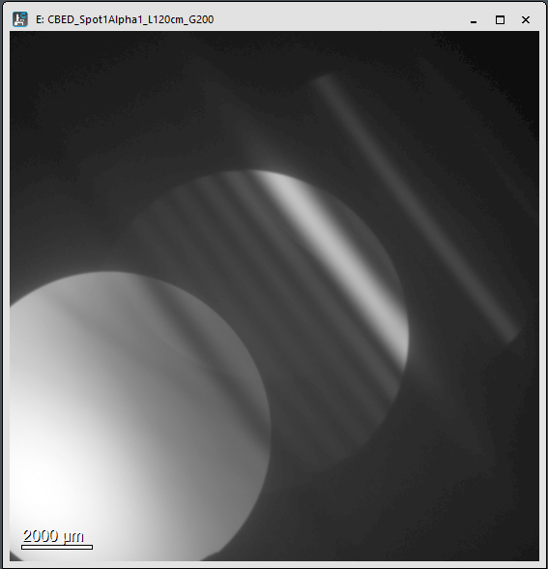
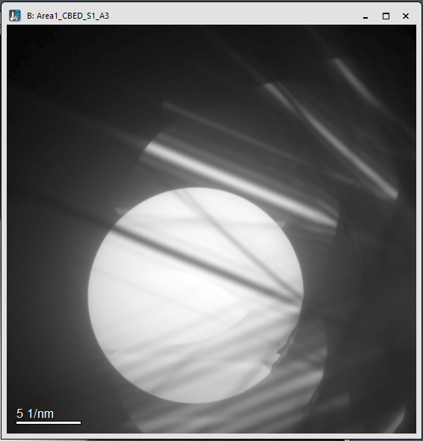
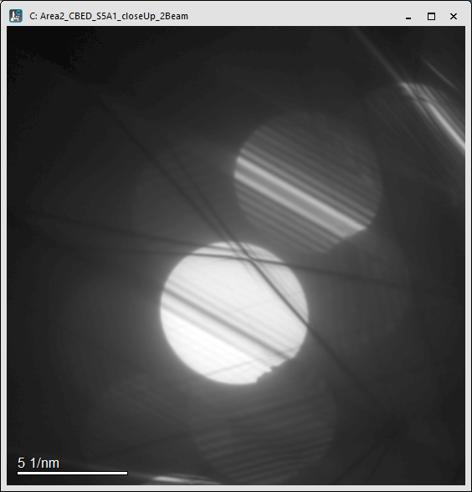
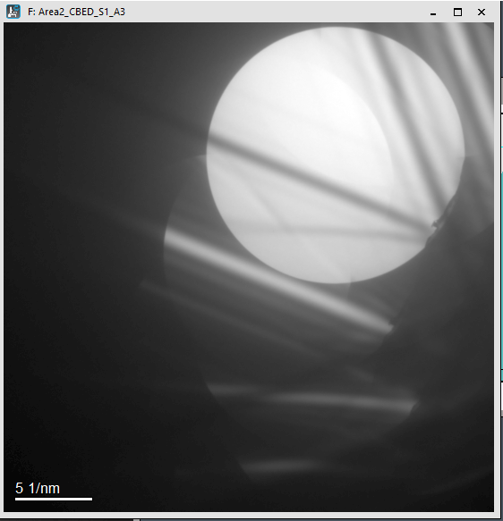
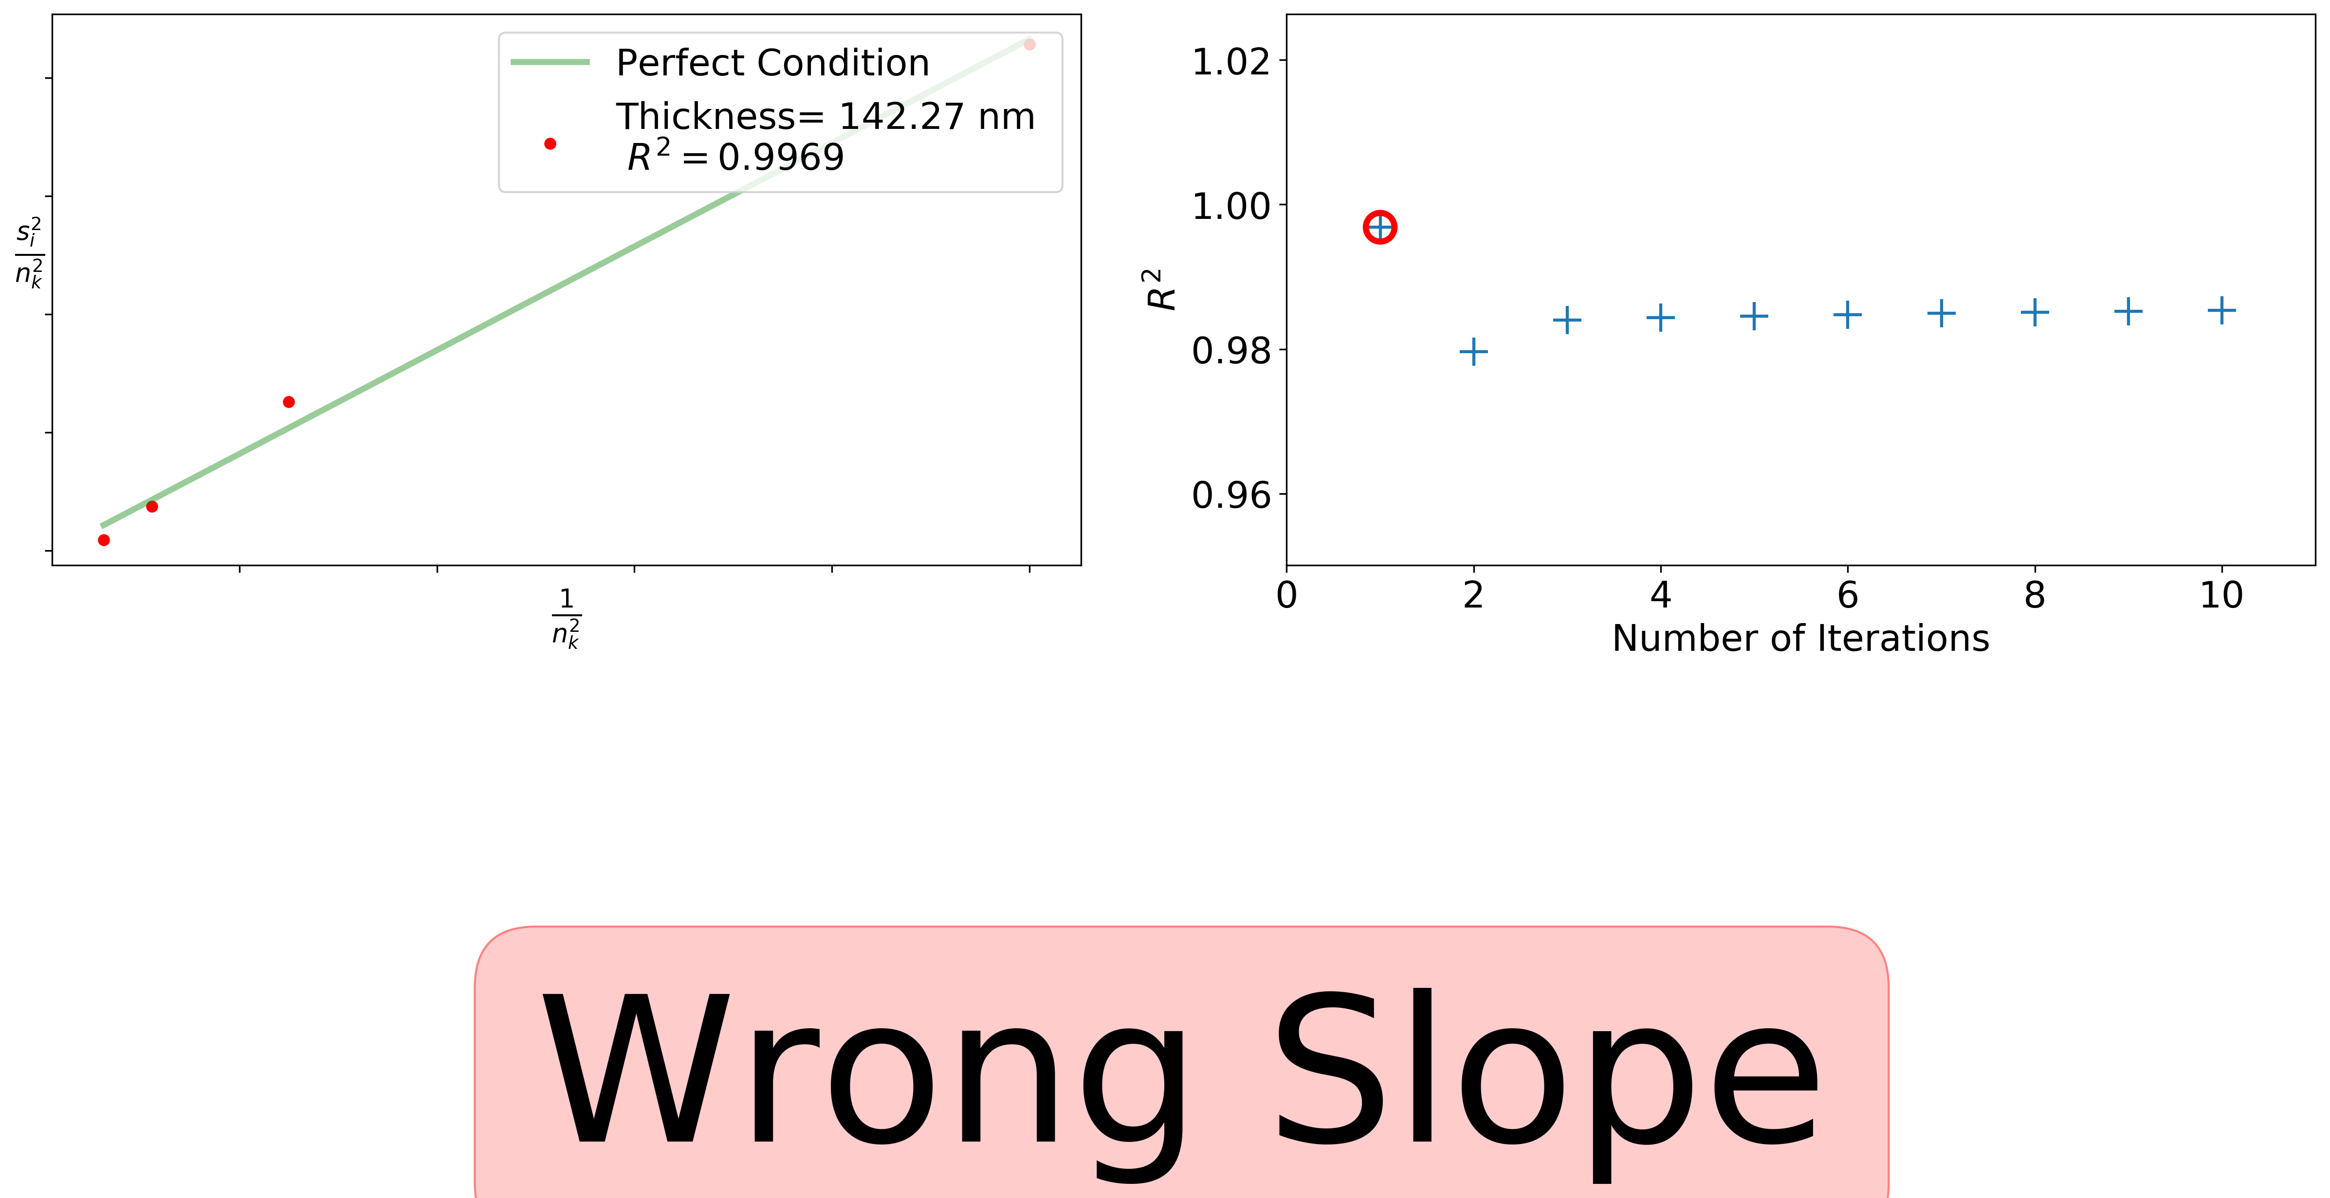
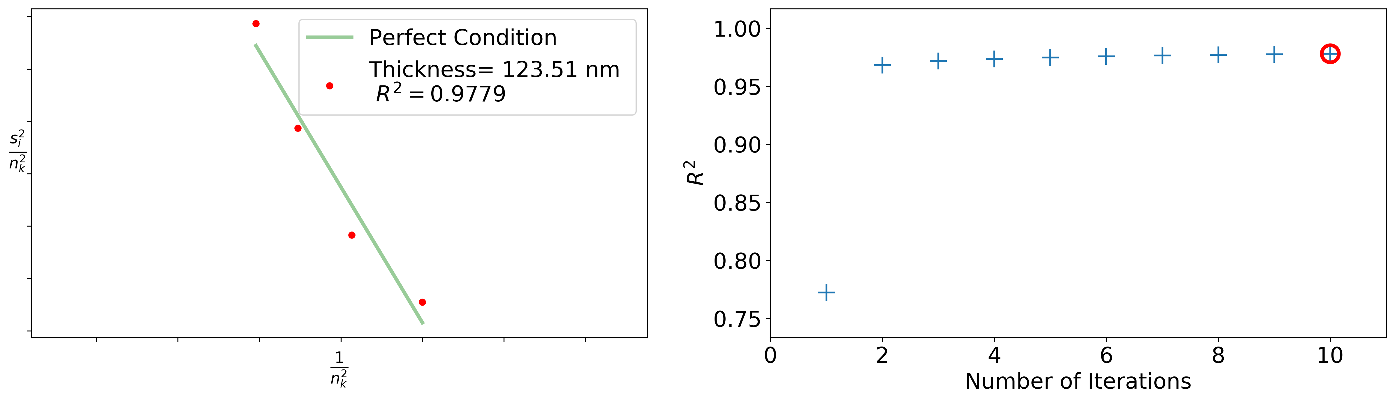
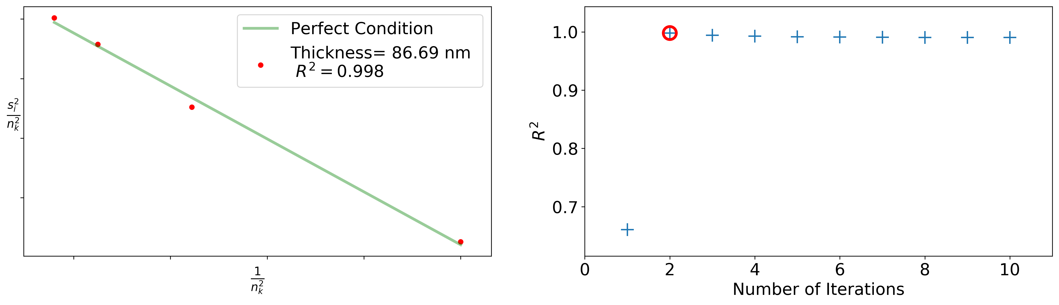
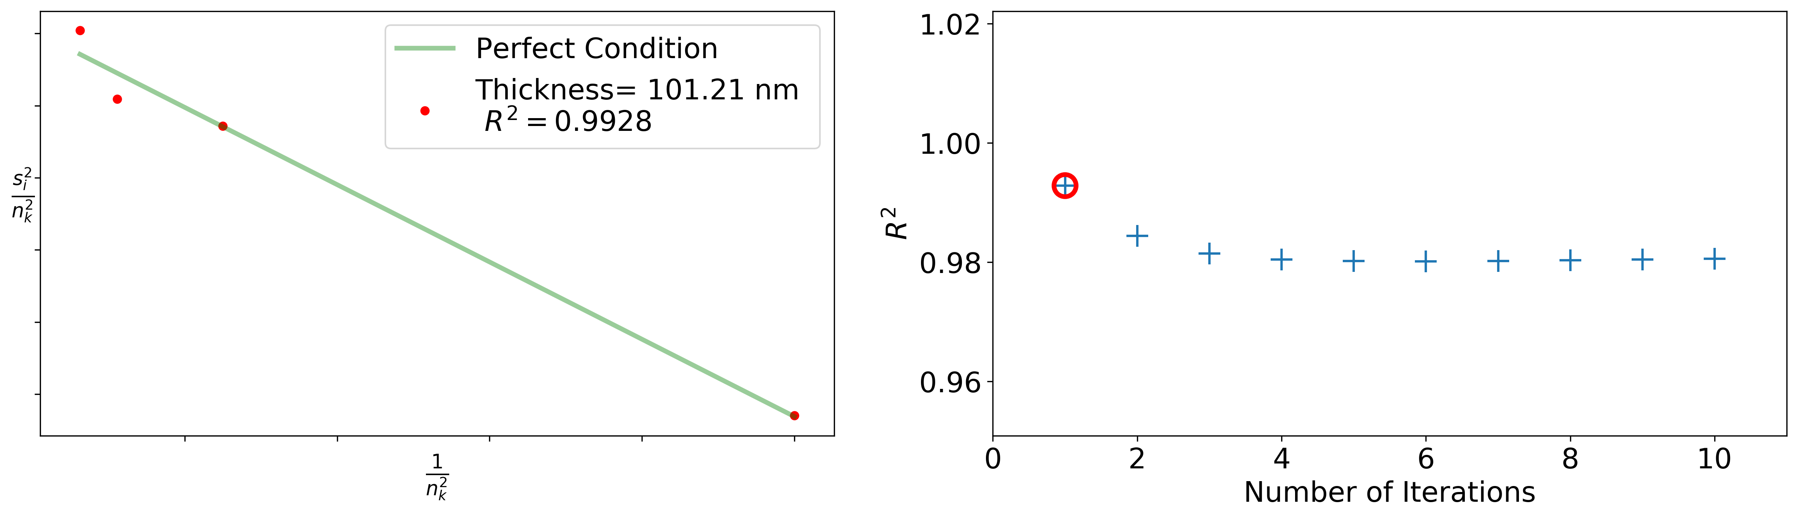
Hints & “the program”
A nice CBED pattern doesn’t mean that they give nice results. Especially not if taken with poorely/not at all aligned conditions.
A perfect fit must be found to be able to extract the location of the g-spot in the rocking curve.
Hint: Align TEM in spotsize 3, condenser aperture 2 (70µm) and use it for the BF/DF and CBED micrographs.
It takes sometimes more iterations, but trustworthy results should not exceed ~ 4 iterations
Hint: Align TEM in spotsize 3 and use it for the BF/DF and CBED micrographs.
The higher R² value the better the fit
Make sure that only 2 beams are excited to avoid faulty pattern!!!

Slide 12
Possible & Planned Extensions of Program
Planned:
- Writing an interactive Jupyter notebook
Possible:
- Thickness range
Allen’s refinement (taking additionally maxima locations)
Comparing with/ retrieving extinction length
Fully automation

Slide 13
The End

Slide 14
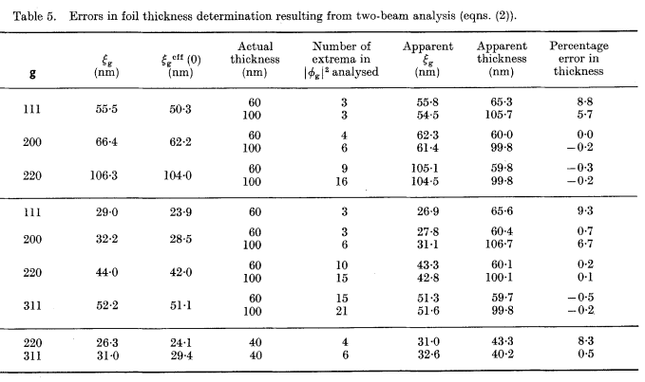
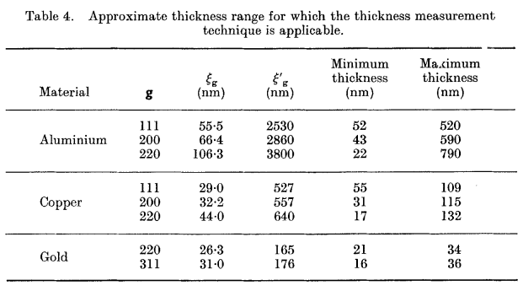
Nice-to-now
Allen 1981

Slide 15
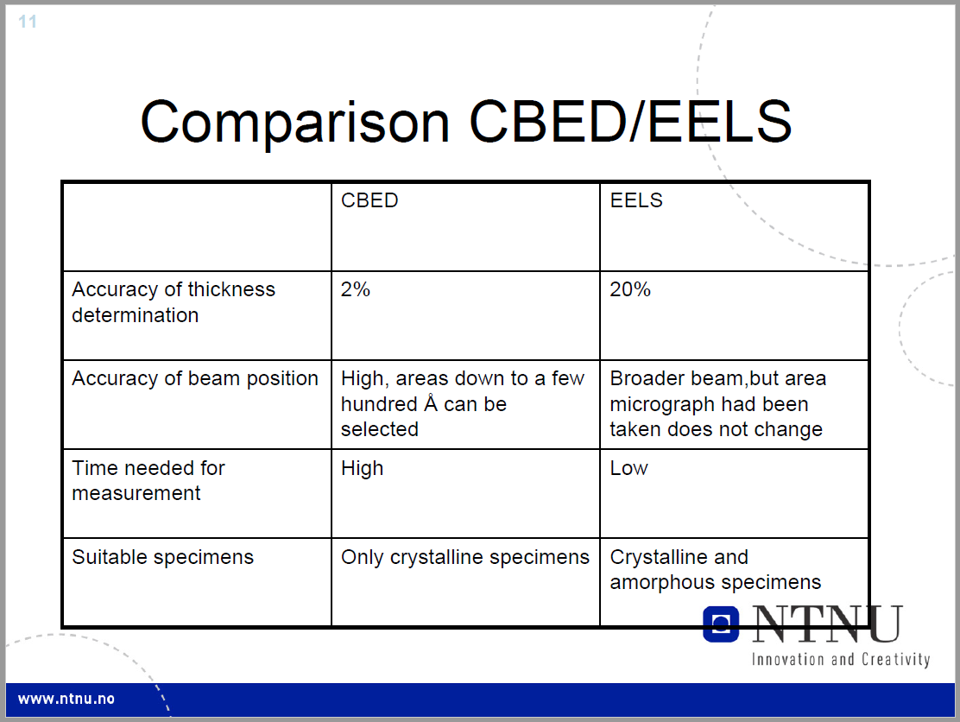
Tina’s Summary

